Slide 1
Chapter 3
Structure of a C Program
Objectives
❏ To be able to list and describe the six expression categories
❏ To understand the rules of precedence and associativity in evaluating expressions
❏ To understand the result of side effects in expression evaluation
❏ To be able to predict the results when an expression is evaluated
❏ To understand implicit and explicit type conversion
❏ To understand and use the first four statement types: null, expression, return, and compound

Slide 2
3-1 Expressions
An expression is a sequence of operands and operators that reduces to a single value. Expressions can be simple or complex. An operator is a syntactical token that requires an action be taken. An operand is an object on which an operation is performed; it receives an operator’s action.
Topics discussed in this section:
Primary Expressions
Postfix Expressions
Prefix Expressions
Unary Expressions
Binary Expressions

Slide 3
Note
An expression always reduces to a single value.

Slide 4
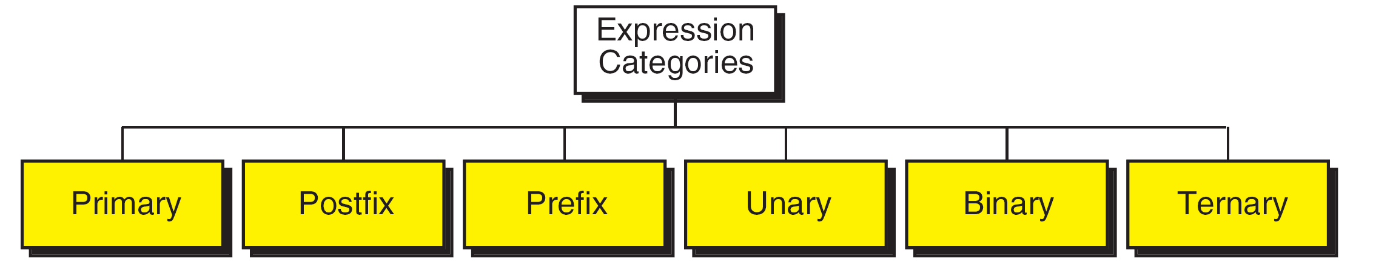
FIGURE 3-1 Expression Categories

Slide 5
Primary Expressions
Names
a, b12, price, INT_MAX, SIZE
Literal constants
5, 123.98, ‘A’, “Welcome”
Parenthetical expressions
(2 * 3 + 4), (a = 23 + b * 6)

Slide 6
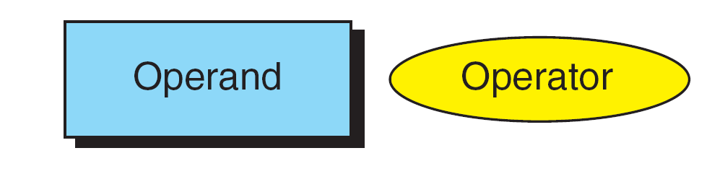
FIGURE 3-2 Postfix Expressions

Slide 7
Note
(a++) has the same effect as (a = a + 1)

Slide 8
FIGURE 3-3 Result of Postfix a++

Slide 9
Note
The operand in a postfix expression must be a variable.

Slide 10
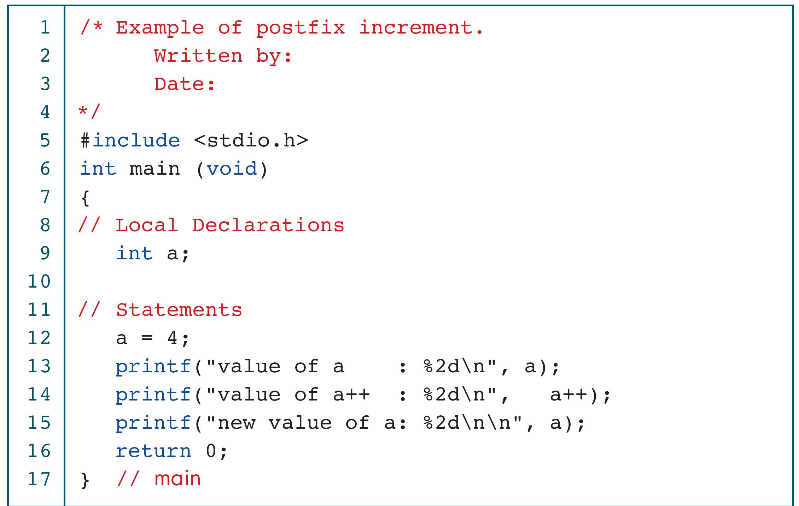
PROGRAM 3-1
Demonstrate Postfix Increment

Slide 11
PROGRAM 3-1
Demonstrate Postfix Increment (continued)

Slide 12
Function Call
A postfix expression
Function call operator ()
printf(“hello world\n”)

Slide 13
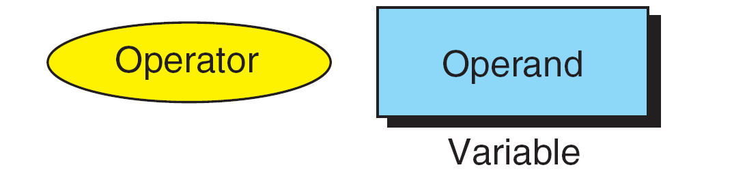
FIGURE 3-4 Prefix Expression

Slide 14
Note
(++a) has the same effect as (a = a + 1)

Slide 15
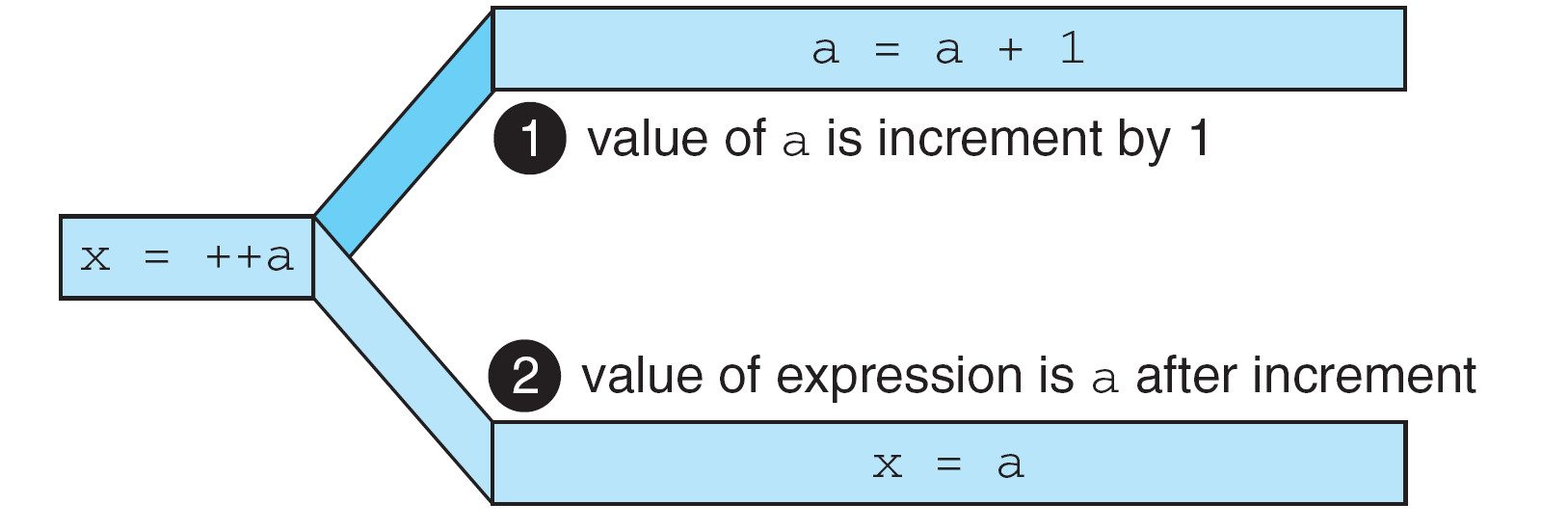
FIGURE 3-5 Result of Prefix ++a

Slide 16
Note
The operand of a prefix expression must be a variable.

Slide 17
PROGRAM 3-2
Demonstrate Prefix Increment

Slide 18
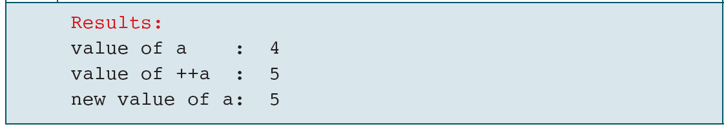
PROGRAM 3-2
Demonstrate Prefix Increment (continued)

Slide 19
Note
If ++ is after the operand, as in a++, the increment takes place after the expression is evaluated.
If ++ is before the operand, as in ++a, the increment
takes place before the expression is evaluated.

Slide 20
FIGURE 3-6 Unary Expressions

Slide 21
Table 3-1
Examples of Unary Plus And Minus Expressions

Slide 22
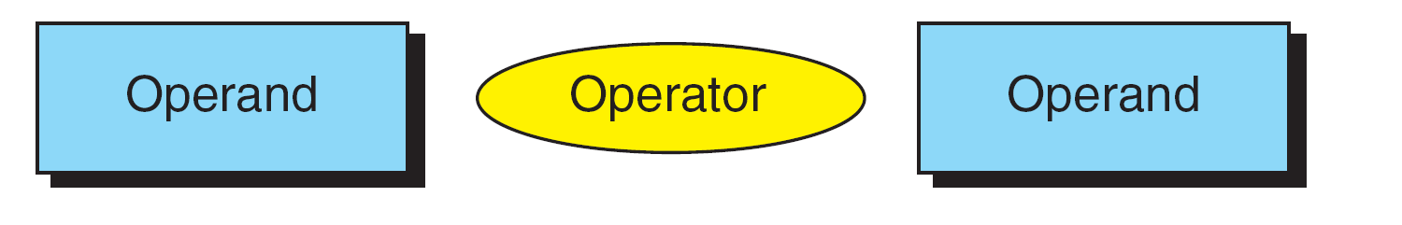
FIGURE 3-7 Binary Expressions

Slide 23
Binary Expressions
10 * 3, true * 4, ‘A’ * 2, 22.3 * 2
10 / 3, true / 4, ‘A’ / 2, 22.3 / 2
10 % 3, true % 4, ‘A’ % 2, 22.3 % 2
3 / 5, 3 % 5
3 + 7, 3 – 7
a = 5, b = x + 1, i = i + 1

Slide 24
Note
Both operands of the modulo operator (%) must be integral types.

Slide 25
PROGRAM 3-3
Binary Expressions

Slide 26
PROGRAM 3-3
Binary Expressions (continued)

Slide 27
PROGRAM 3-3
Binary Expressions (continued)

Slide 28
Note
The left operand in an assignment expression must be a single variable.

Slide 29
Table 3-2
Expansion of Compound Expressions

Slide 30
PROGRAM 3-4
Demonstration of Compound Assignments

Slide 31
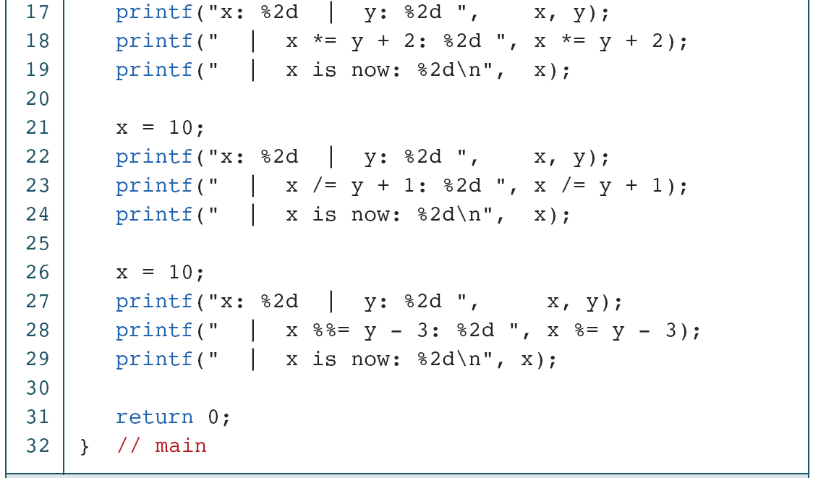
PROGRAM 3-4
Demonstration of Compound Assignments

Slide 32
PROGRAM 3-4
Demonstration of Compound Assignments

Slide 33
3-2 Precedence and Associativity
Precedence is used to determine the order in which different operators in a complex expression are evaluated. Associativity is used to determine the order in which operators with the same precedence are evaluated in a complex expression.
Topics discussed in this section:
Precedence
Associativity

Slide 34
PROGRAM 3-5
Precedence

Slide 35
PROGRAM 3-5
Precedence

Slide 37
a + b + c + d
a * b * c * d
FIGURE 3-8 Left-to-Right Associativity

Slide 38
a = b = c = d = 10
FIGURE 3-9 Right-to-Left Associativity

Slide 39
3-3 Side Effects
A side effect is an action that results from the evaluation of an expression. For example, in an assignment, C first evaluates the expression on the right of the assignment operator and then places the value in the left variable. Changing the value of the left variable is a side effect.

Slide 40
Side Effects
x = 4;
x = x + 4;
a++
printf(“x = %d\n”, x);
printf(“x = %d\n”, x = x + 4);
scanf(“%d”, &x);

Slide 41
Side Effects
A side effect also means an unexpected change due to the use of a global variable
You are advised not use a global variable!
A clear example of this kind of side effect could be made when we have multiple functions

Slide 42
3-4 Evaluating Expressions
Now that we have introduced the concepts of precedence, associativity, and side effects, let’s work through some examples.
Topics discussed in this section:
Expressions without Side Effects
Expressions with Side Effects

Slide 43
Expressions and Side Effects
a * 4 + b / 2 – c * b
d = a * 4 + b / 2 – c * b
f = a * 4 + b++ / 2 – c * --b

Slide 44
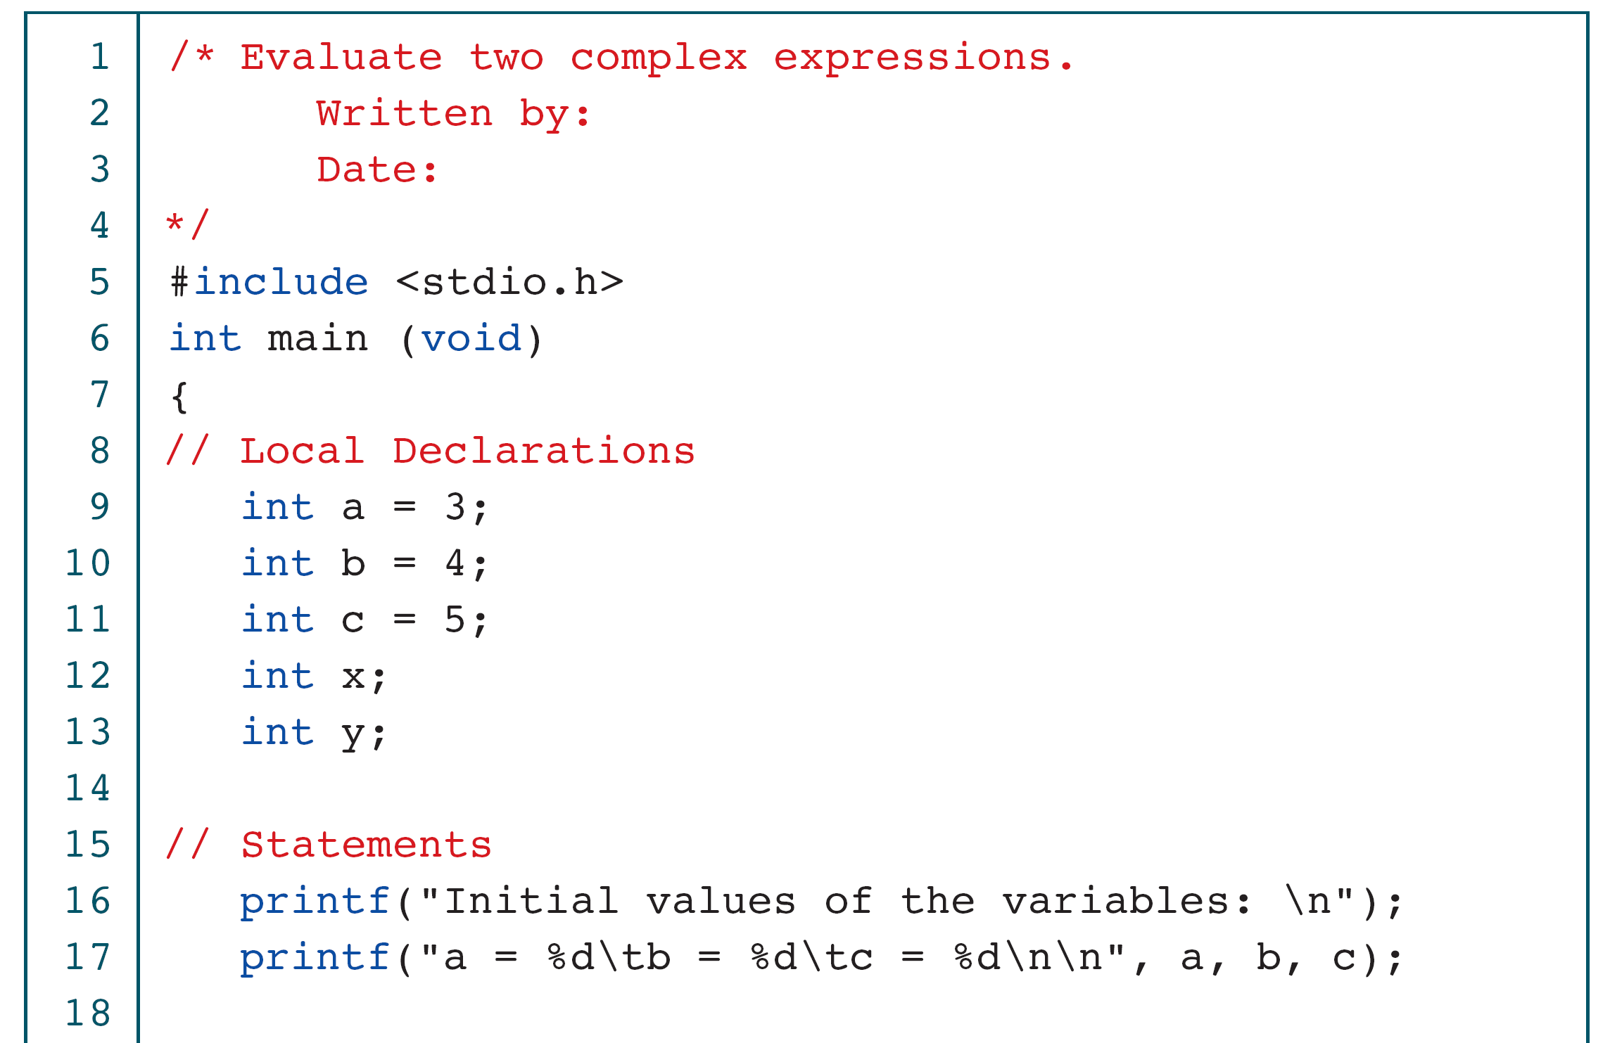
PROGRAM 3-6
Evaluating Expressions

Slide 45
PROGRAM 3-6
Evaluating Expressions

Slide 46
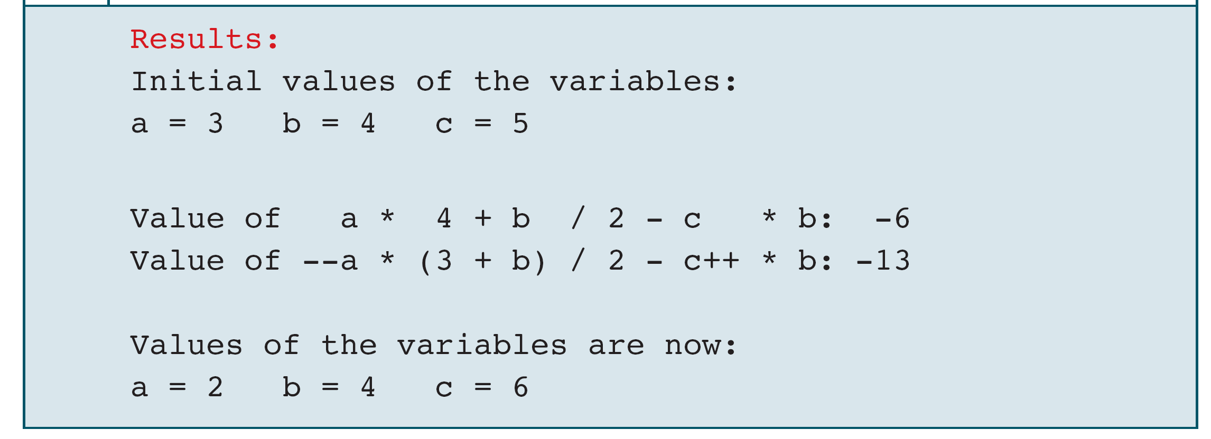
PROGRAM 3-6
Evaluating Expressions

Slide 47
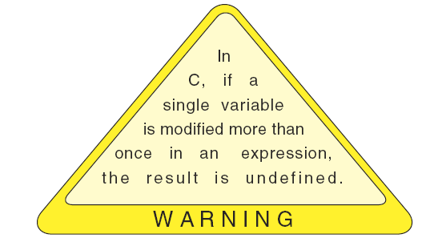
Warning

Slide 48
3-5 Type Conversion
Up to this point, we have assumed that all of our expressions involved data of the same type. But, what happens when we write an expression that involves two different data types, such as multiplying an integer and a floating-point number? To perform these evaluations, one of the types must be converted.
Topics discussed in this section:
Implicit Type Conversion
Explicit Type Conversion (Cast)

Slide 49
Promotion
Demotion
FIGURE 3-10 Conversion Rank

Slide 50
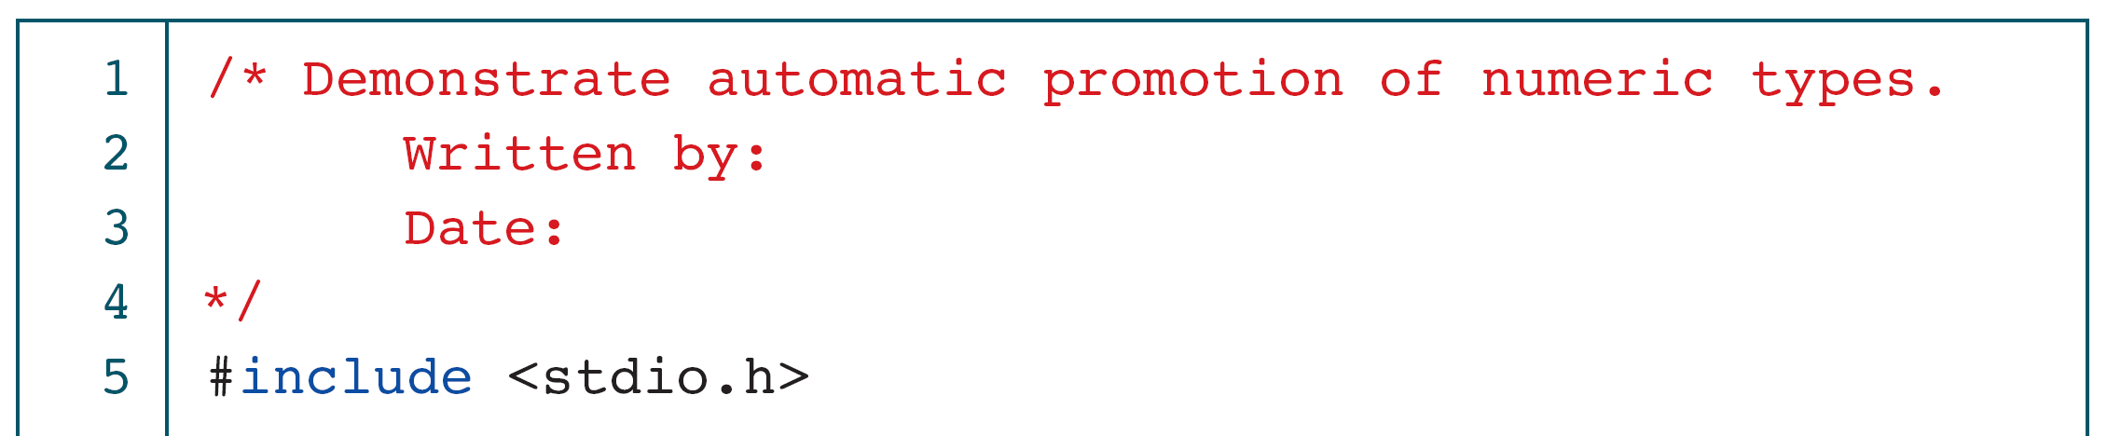
PROGRAM 3-7
Implicit Type Conversion

Slide 51
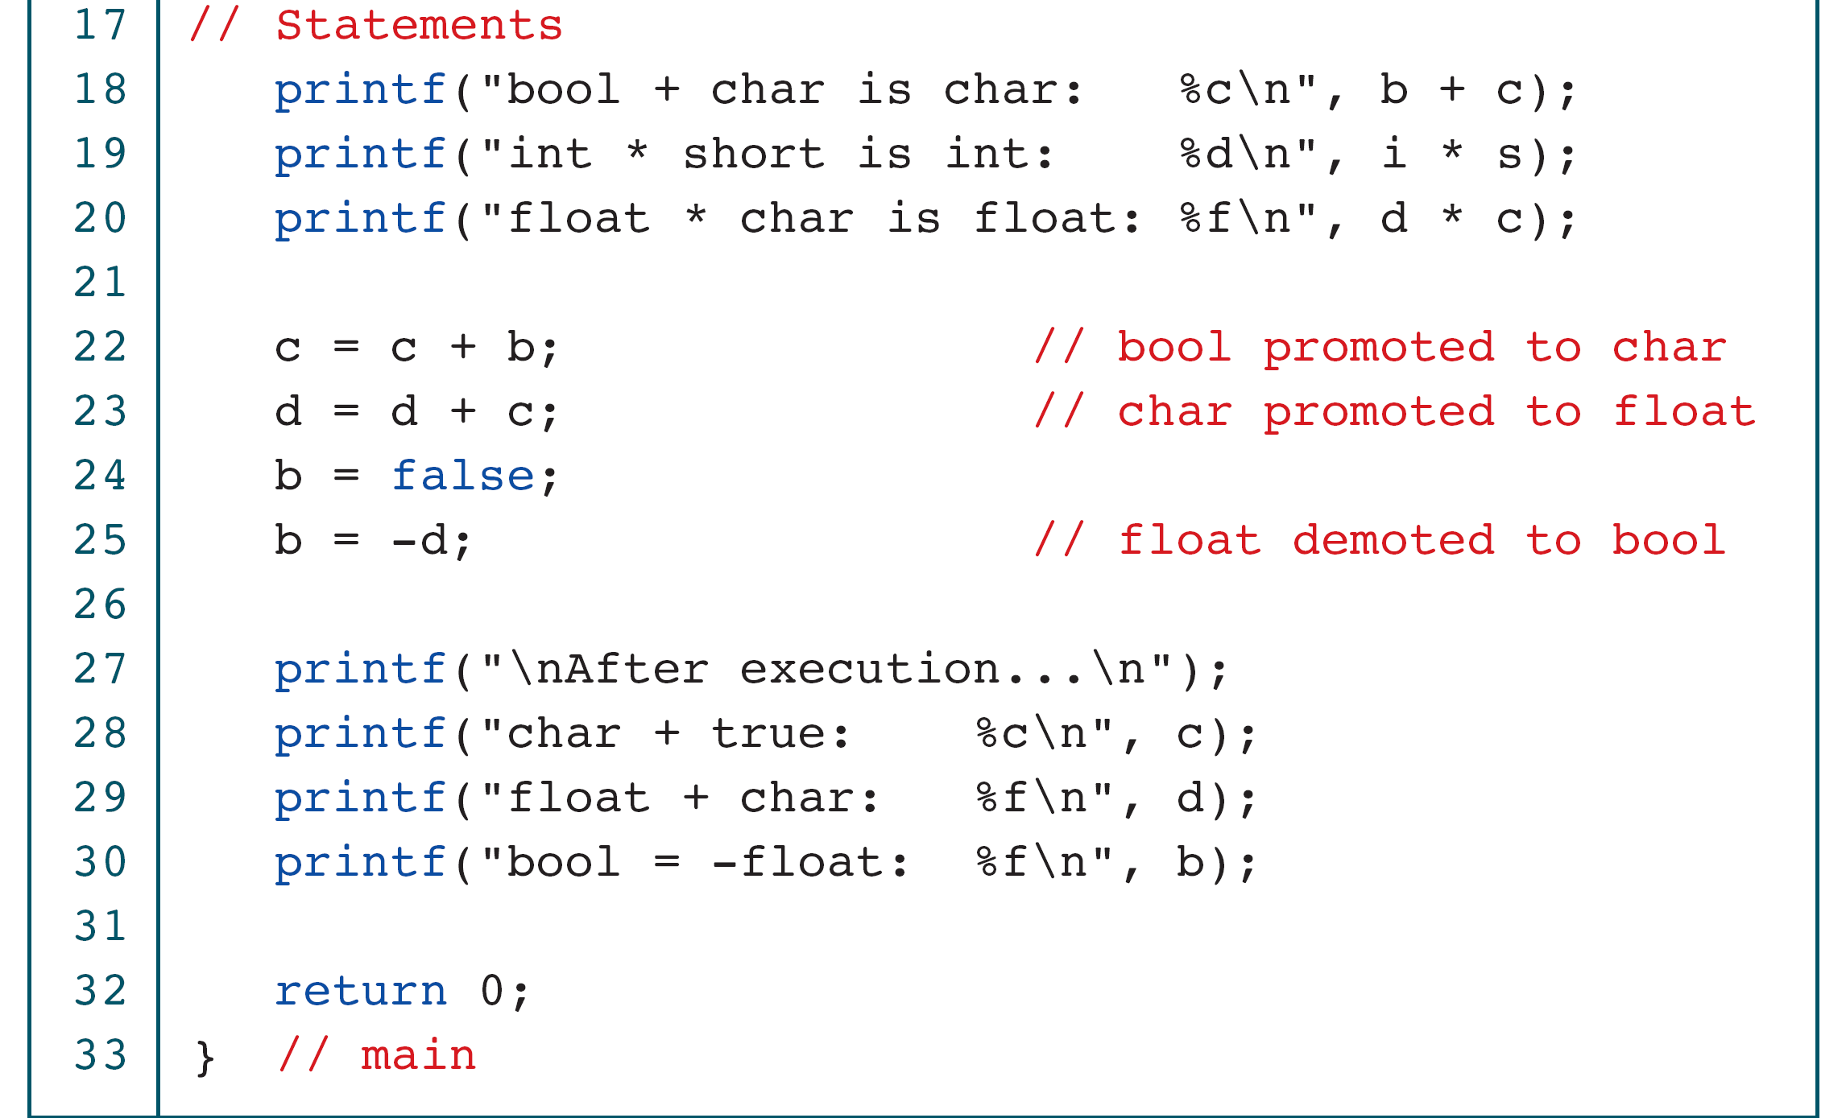
PROGRAM 3-7
Implicit Type Conversion

Slide 52
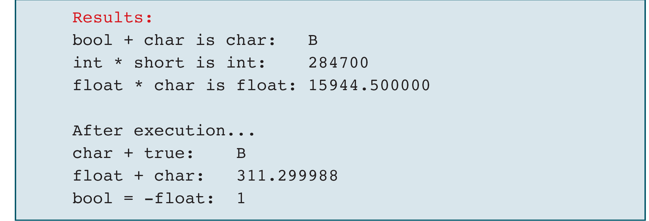
PROGRAM 3-7
Implicit Type Conversion

Slide 53
Explicit Type Conversion: Cast
Cast Operator: (type-to-cast) operand
Example int a=3; float b=4.0; b = (float)a;

Slide 54
PROGRAM 3-8
Explicit Casts

Slide 55
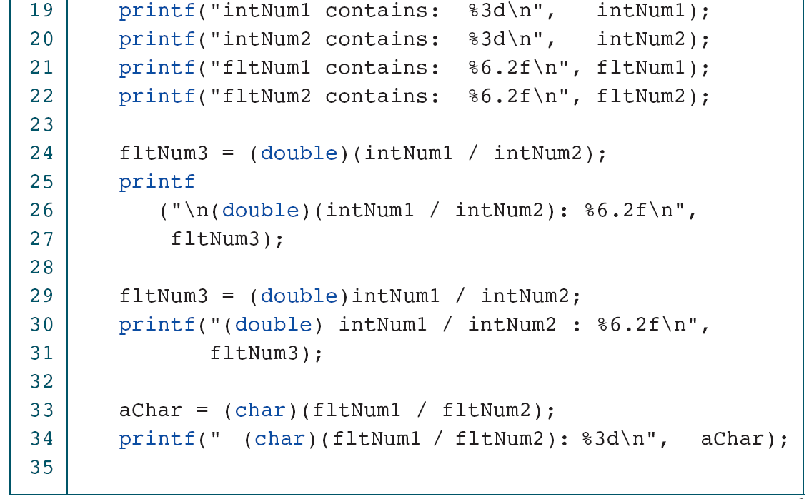
PROGRAM 3-8
Explicit Casts

Slide 56
PROGRAM 3-8
Explicit Casts

Slide 57
3-6 Statements
A statement causes an action to be performed by the program. It translates directly into one or more executable computer instructions.
You may have noticed that we have used a semicolon at the end of the statements in our programs. Most statements need a semicolon at the end; some do not.
Topics discussed in this section:
Statement Type
The Role of the Semicolon
Statements and Defined Constants

Slide 58
FIGURE 3-11 Types of Statements

Slide 59
Null Statement
Just a semicolon
Example ; // null statement
They do nothing, but are still valid syntactical objects.

Slide 60
Expression Statement
A statement consisting of an expression
Example expression; a = 2; b = c = 3;

Slide 61
Return Statement
A return statement terminates a function.
Example
return;
return expression;

Slide 62
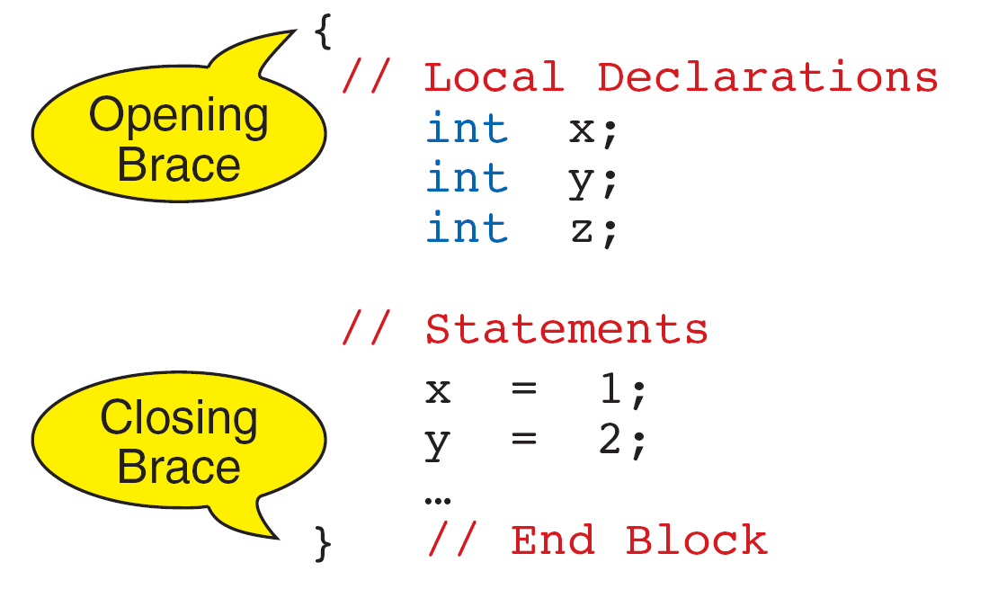
FIGURE 3-12 Compound Statement

Slide 63
Note
The compound statement does not need a semicolon.

Slide 64
The Role of the Semicolon
Every declaration in C is terminated by a semicolon
Most statements in C are terminated by a semicolon

Slide 65
Statements and Defined Constants
#define TAX_RATE 0.825
tax = TAX_RATE * amount;

Slide 66
3-7 Sample Programs
This section contains several programs that you should study for programming technique and style.

Slide 67
PROGRAM 3-9
Calculate Quotient and Remainder

Slide 68
PROGRAM 3-9
Calculate Quotient and Remainder

Slide 69
PROGRAM 3-10
Print Right Digit of Integer

Slide 70
PROGRAM 3-10
Print Right Digit of Integer

Slide 71
PROGRAM 3-11
Calculate Average of Four Numbers

Slide 72
PROGRAM 3-11
Calculate Average of Four Numbers

Slide 73
PROGRAM 3-11
Calculate Average of Four Numbers

Slide 74
PROGRAM 3-11
Calculate Average of Four Numbers

Slide 75
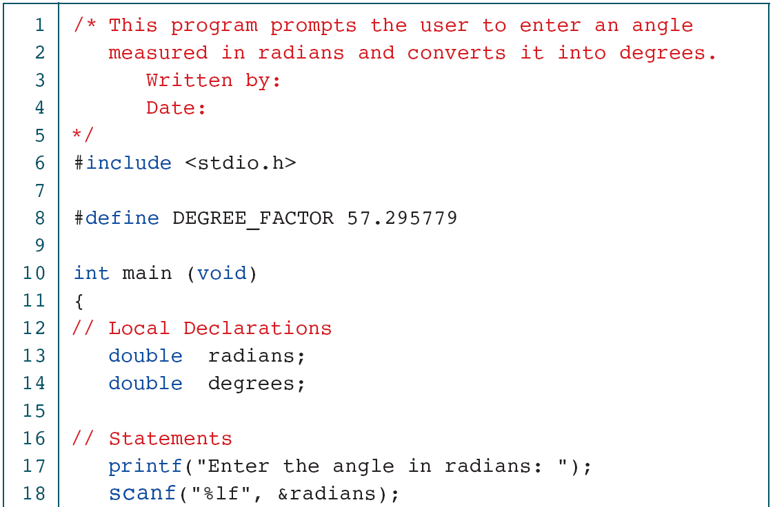
PROGRAM 3-12
Convert Radians to Degrees

Slide 76
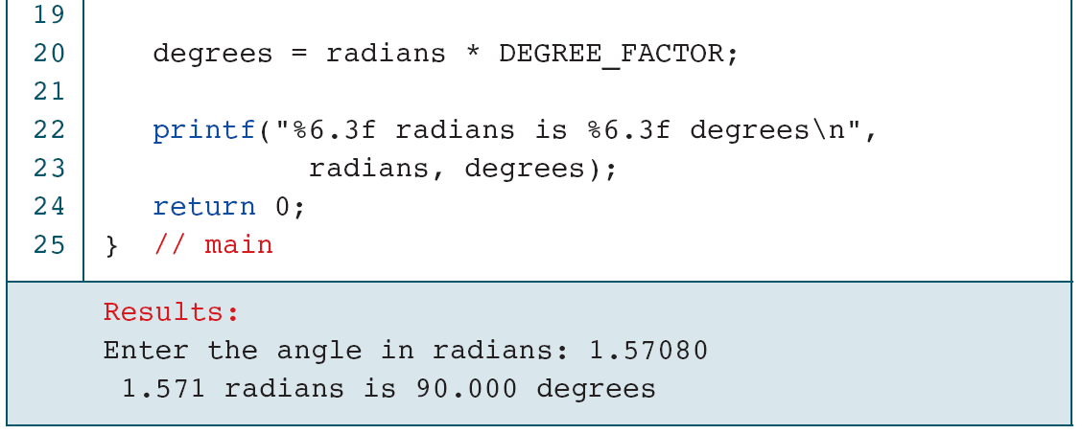
PROGRAM 3-12
Convert Radians to Degrees

Slide 77
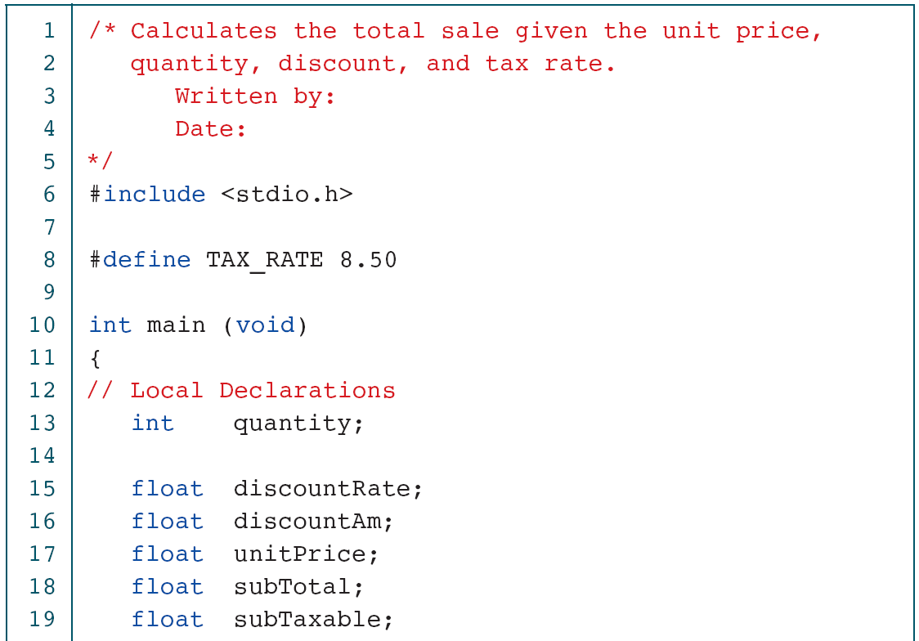
PROGRAM 3-13
Calculate Sales Total

Slide 78
PROGRAM 3-13
Calculate Sales Total

Slide 79
PROGRAM 3-13
Calculate Sales Total

Slide 80
PROGRAM 3-13
Calculate Sales Total

Slide 81
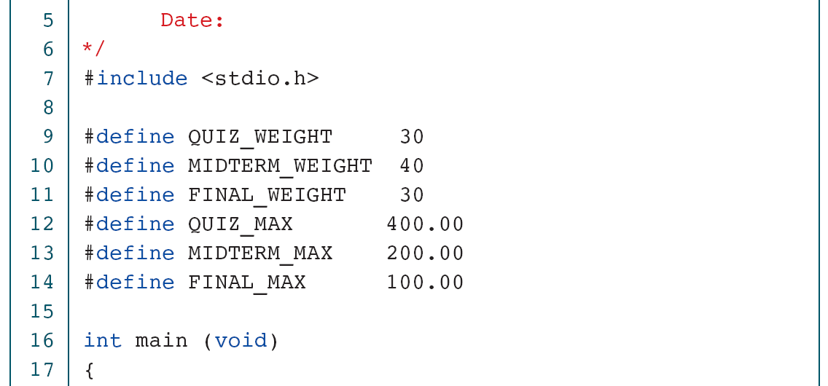
PROGRAM 3-14
Calculate Student Score

Slide 82
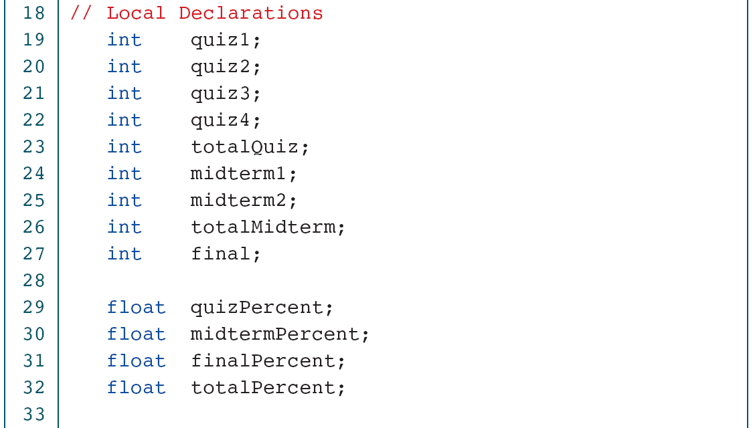
PROGRAM 3-14
Calculate Student Score

Slide 83
PROGRAM 3-14
Calculate Student Score

Slide 84
PROGRAM 3-14
Calculate Student Score

Slide 85
PROGRAM 3-14
Calculate Student Score

Slide 86
PROGRAM 3-14
Calculate Student Score

Slide 87
PROGRAM 3-14
Calculate Student Score

Slide 88
3-8 Software Engineering
In this section we discuss three concepts that, although technically not engineering principles, are important to writing clear and understandable programs.
Topics discussed in this section:
KISS
Parentheses
User Communication

Slide 89
KISS (Keep It Simple and Short)
Note
Blocks of code should be no longer than one screen.

Slide 90
Use parentheses whenever you are not sure of precedence.
Note
Computers do what you tell them to do, not what you intended to tell them to do. Make sure your code is as clear and simple as possible.

Slide 91
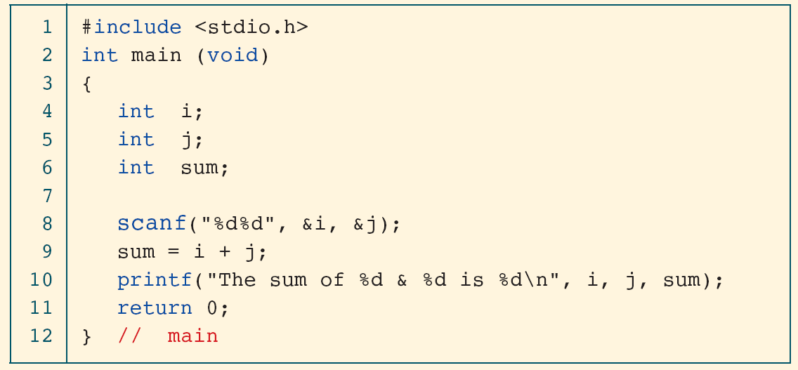
PROGRAM 3-15
Program That Will Confuse the User
Always provide the user with clear information
printf(“Enter two integers and key <return>\n”);

